Slide 1
How to Sign the Lab’s LATCH (Risk Assessment)
Log-in at: gatortracs.ehs.ufl.edu

Slide 2
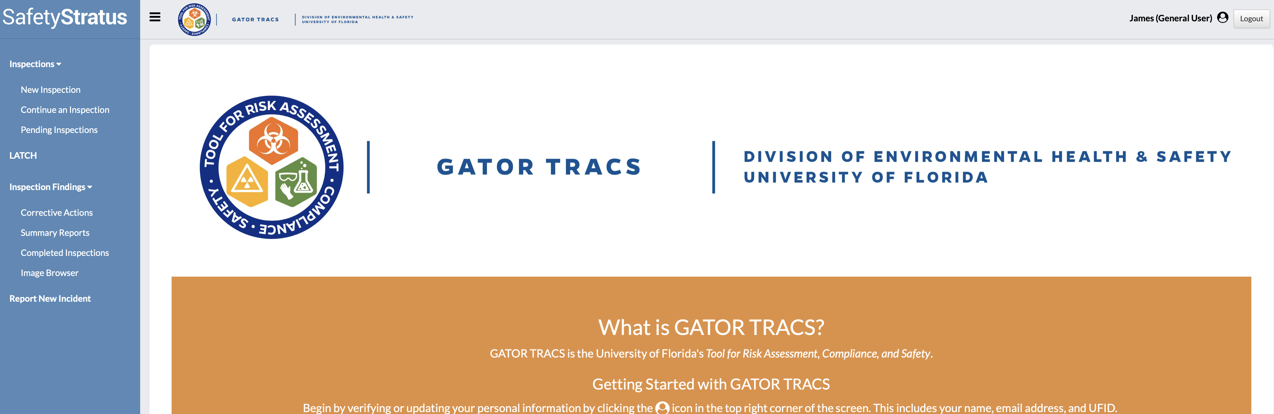
Select “LATCH” to begin.

Slide 3
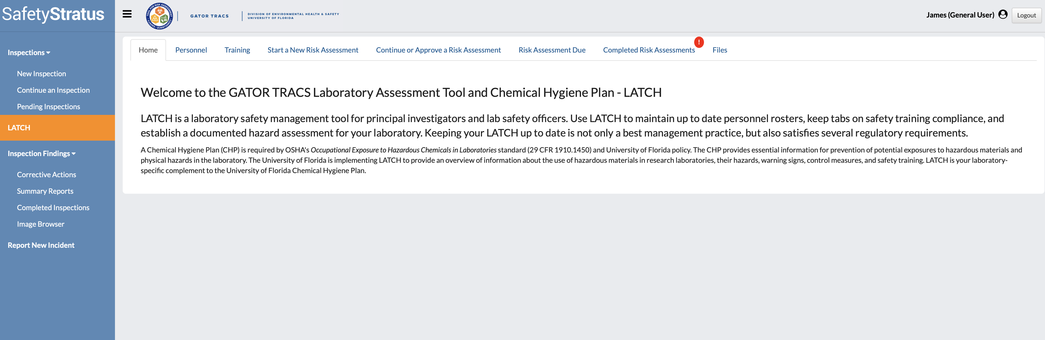
Select “Completed Risk Assessments.”

Slide 4
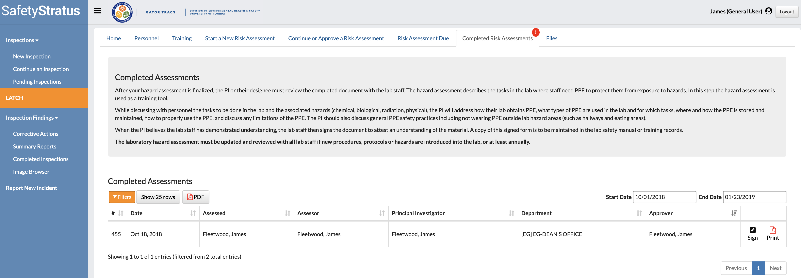
Review the most recent risk assessment by viewing the completion date.
Right click on “Print” to open the pdf in a new tab. When finished reviewing close the new tab to return and sign.
After reviewing the risk assessment click “Sign.”

Slide 5
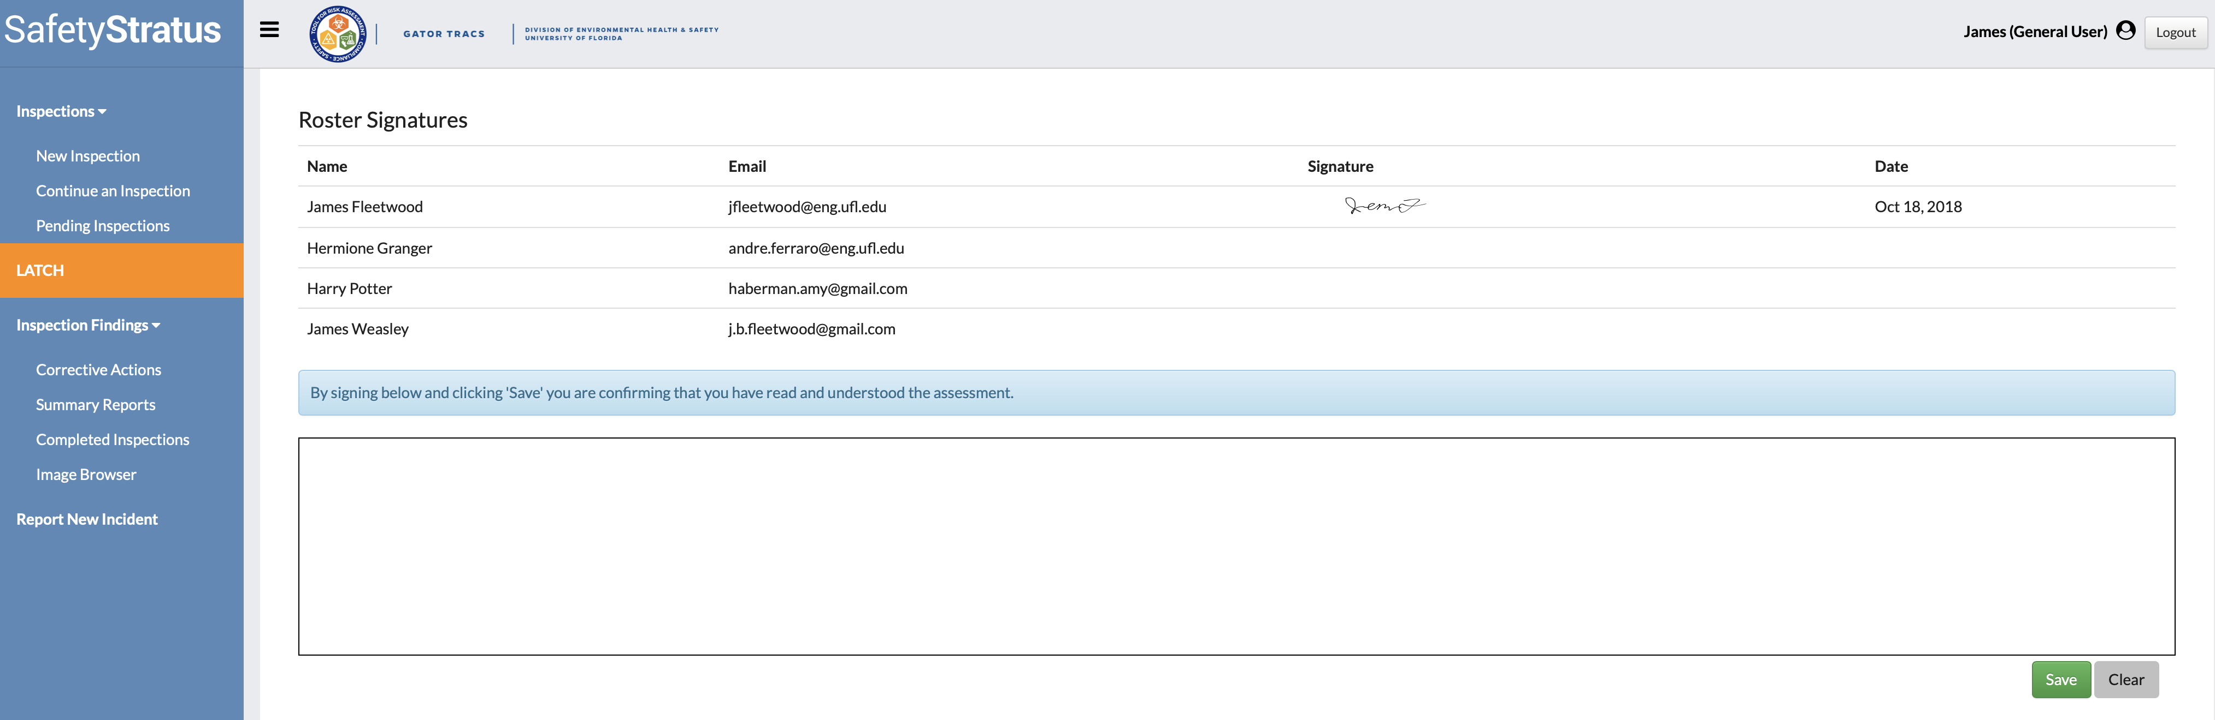
Sign in the text box below using your mouse or touchpad. Click “Save” to confirm.

