Slide 1
HWCOE Self-Inspection Guide

Slide 2
The self-inspection should only be performed using a web browser on a device of your choice (phone, tablet, or desktop).
Labs with multiple rooms may conduct one self-inspection but must inspect each space individually by utilizing the save and continue function.

Slide 3
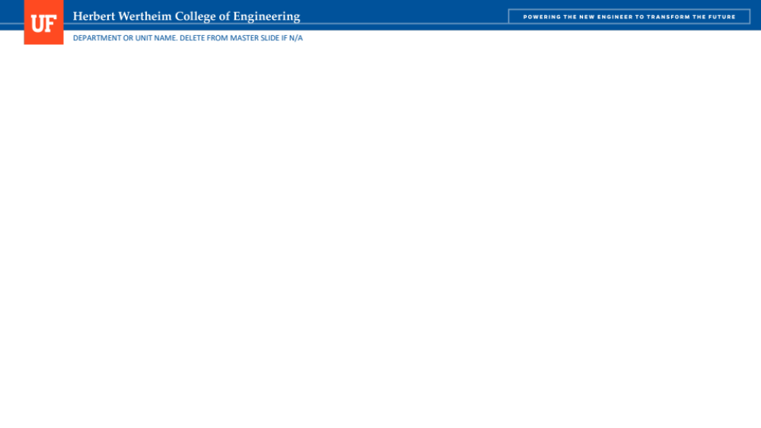
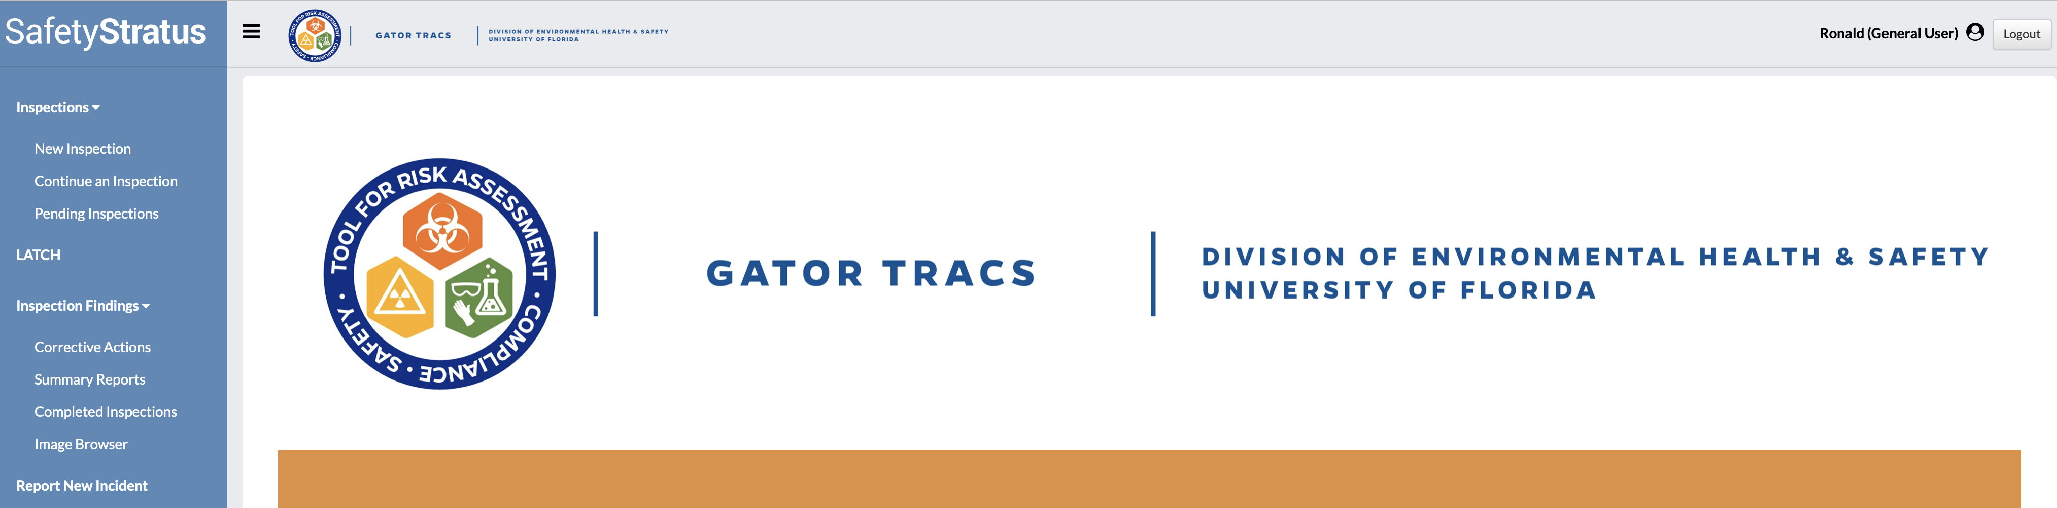
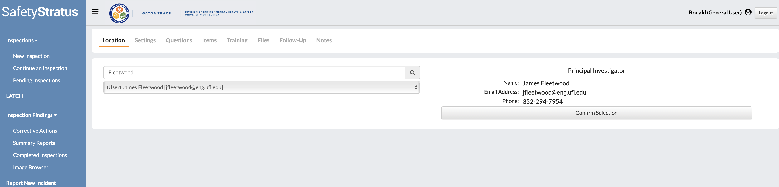

To begin a new inspection click “New Inspection.”
Enter the last name of the PI using the search bar and then select “Confirm Selection” below.

Slide 4
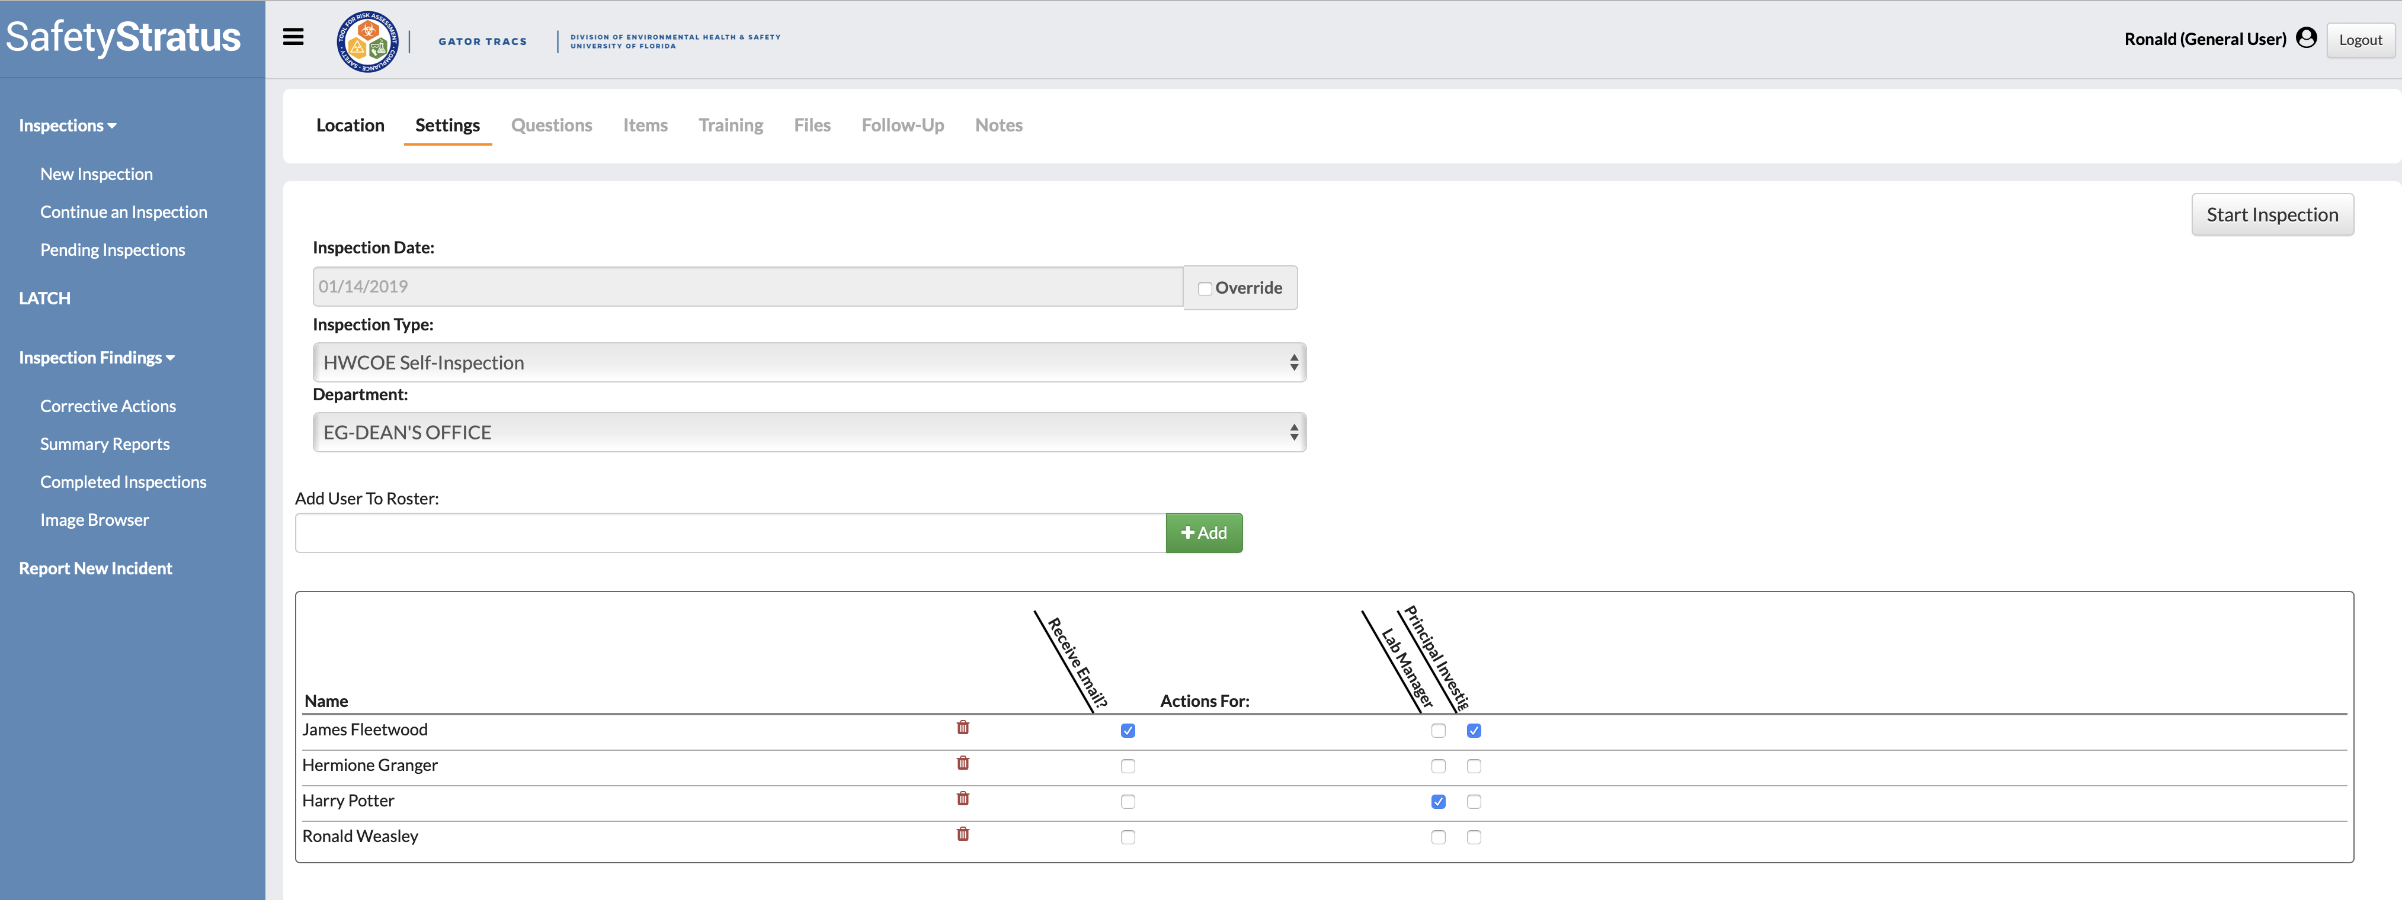
Select the “Receive Email box” to notify the PI that the self-inspection was completed.

Slide 5
Please ensure the lab’s roster is current.
Add users to the roster by typing their name or UF email address using the “Add User To Roster” search bar.

Slide 6
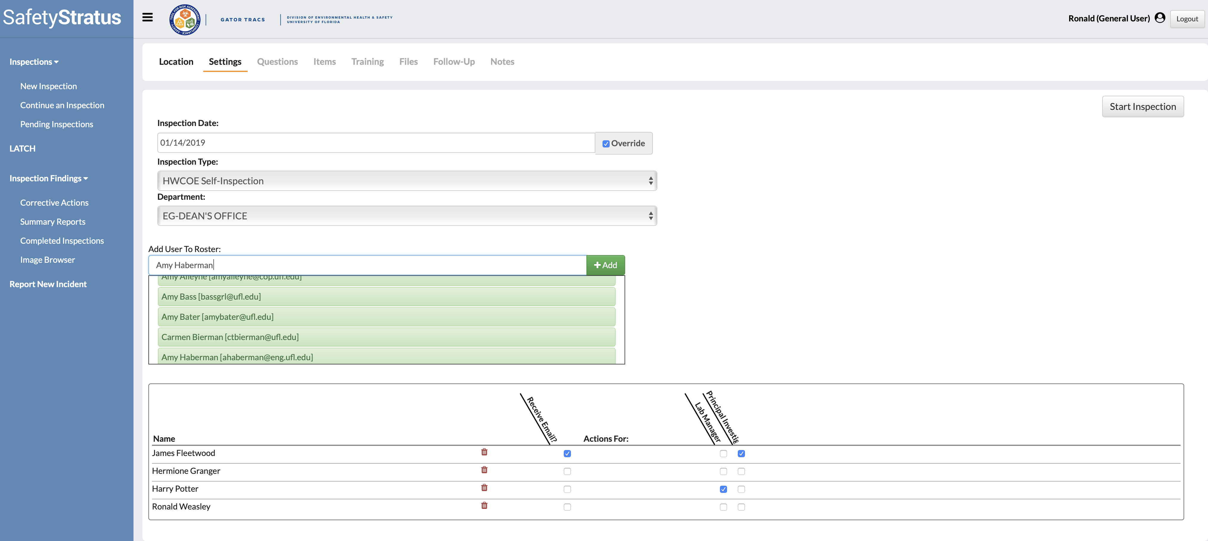
Enter the name of the user you would like to add and click “Add” to confirm.

Slide 7
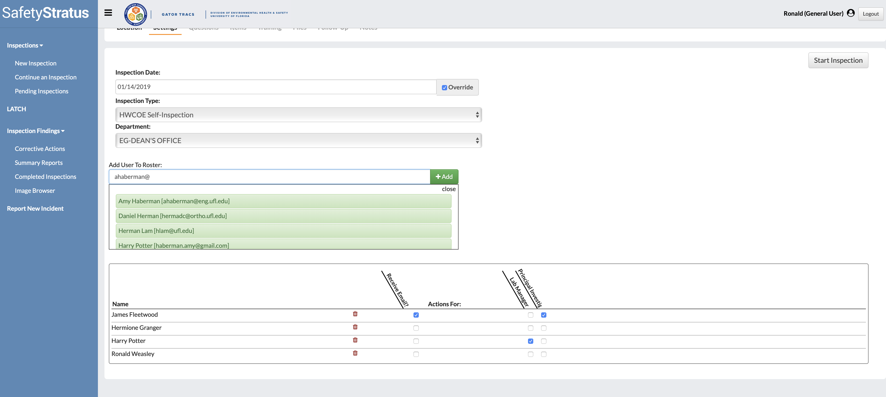
Select the UF email of the user you would like to add and click “Add” to confirm.
Delete users by selecting the red “Trash Can” icon.

Slide 8
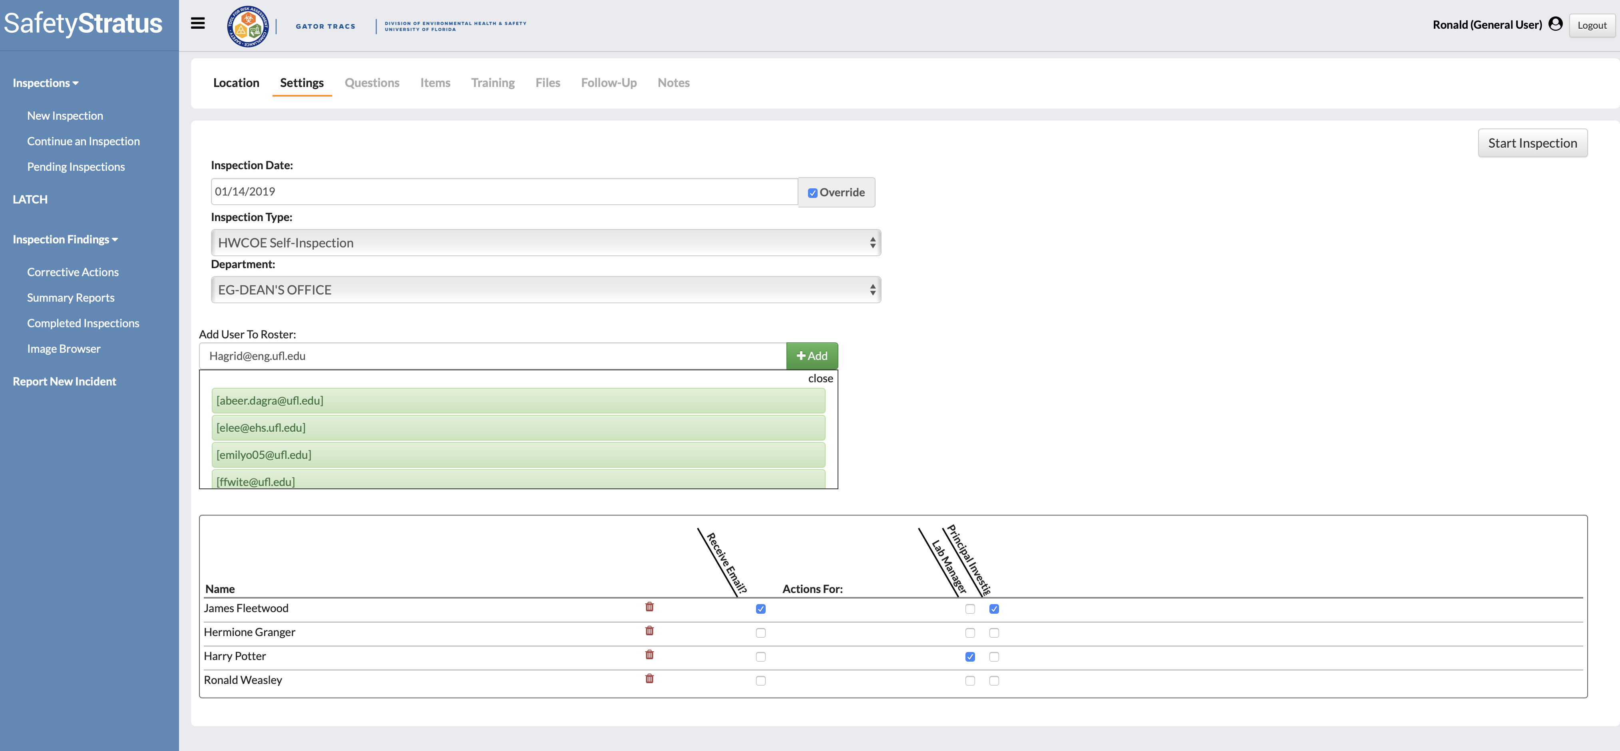
If a user can’t be found by their name or UF email in the drop down box: Enter their UF email address and click “Add.” GatorTracs will email the user prompting them to log-in and update their information.

Slide 9
Once the roster is updated and PI email is selected click “Start Inspection” to begin.

Slide 10
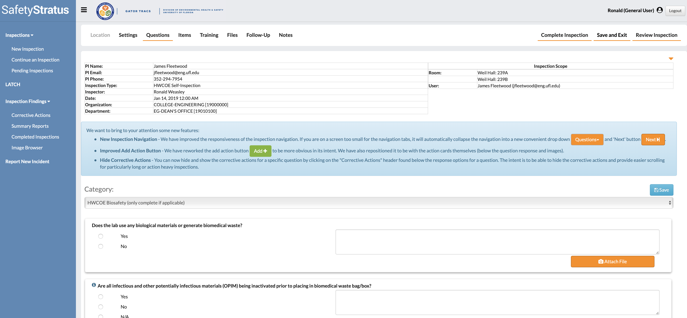
The drop-down box contains 12 categories of questions. Click on the drop-down box to view the remaining “Categories.”

Slide 11
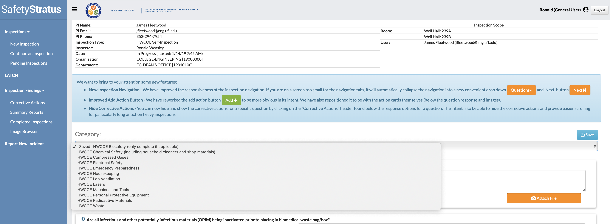
View each set and only complete the categories that are applicable. For example, if your lab only works with chemicals you can skip the Biosafety category.

Slide 12
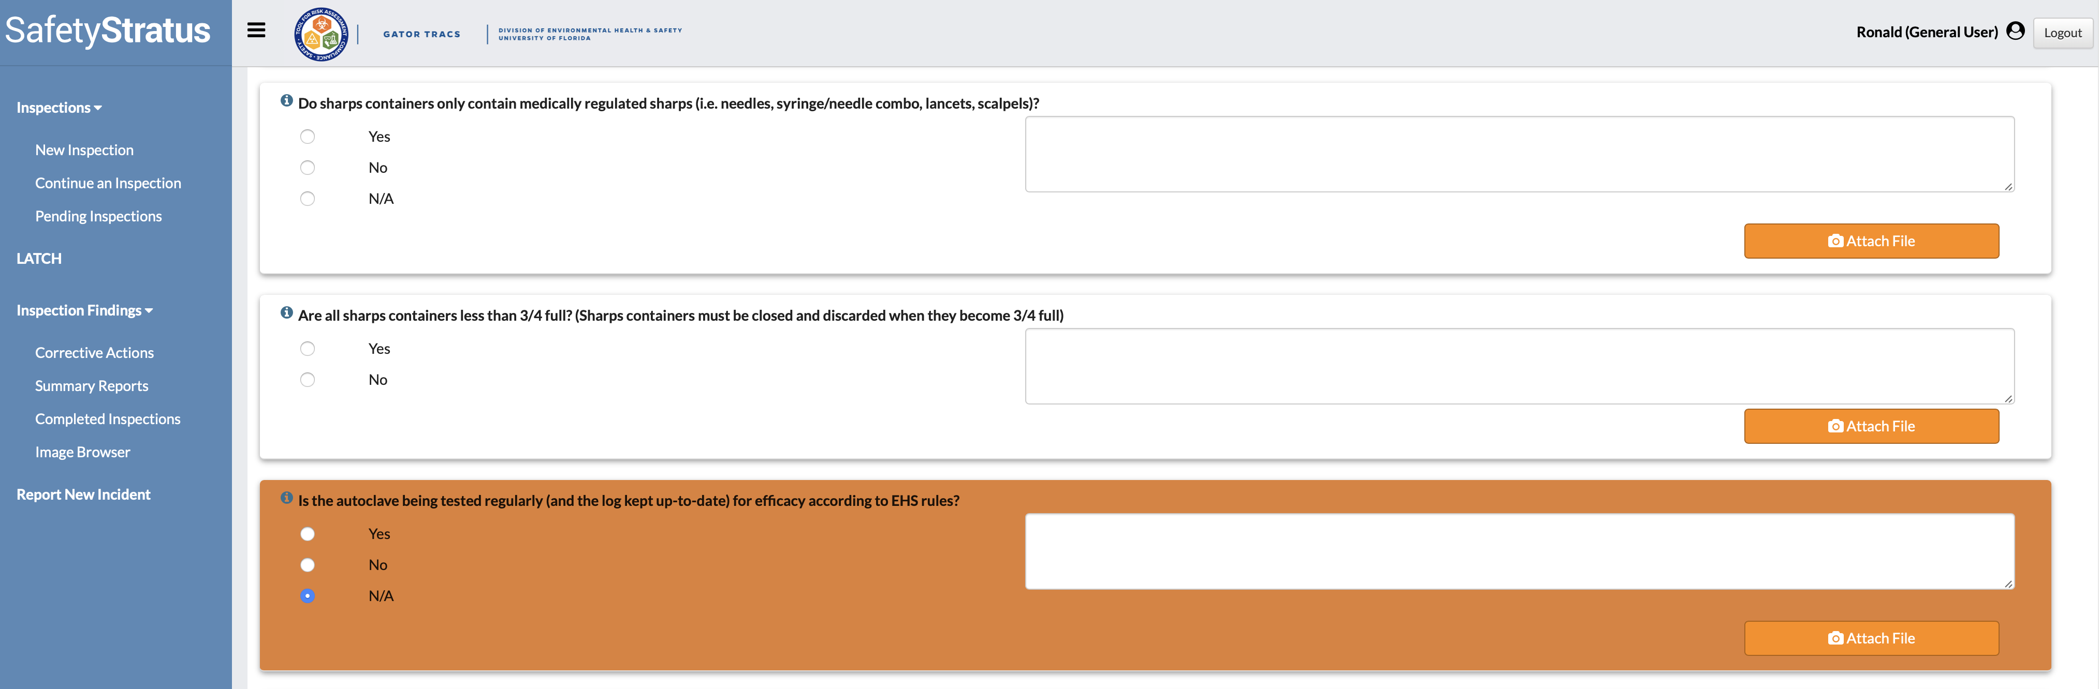
If a question within a Category does not apply to your lab select N/A. For example, your lab works with biohazardous materials but does not have an autoclave.

Slide 13
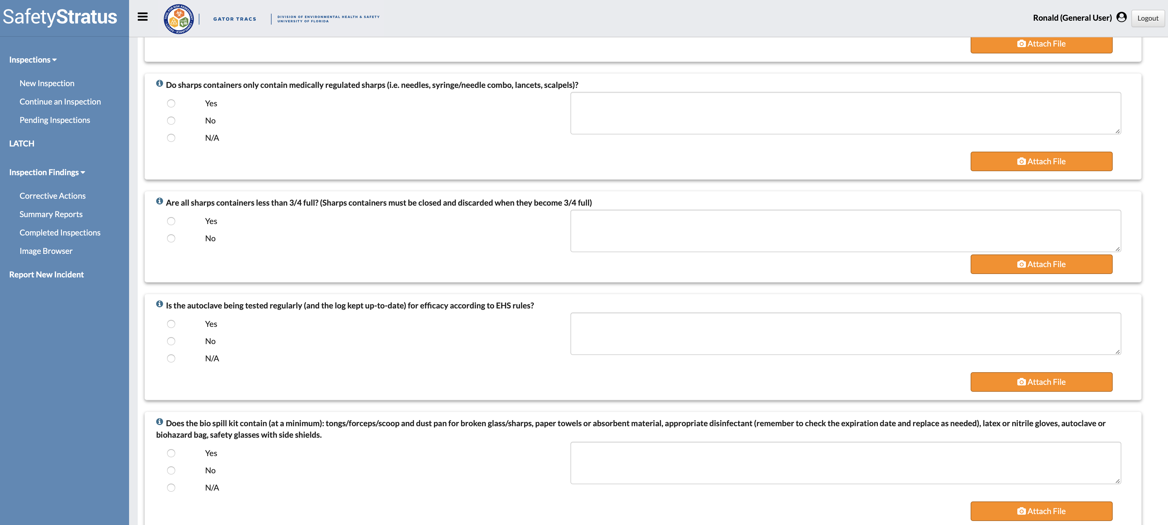
For help or a link to resources click on the “circled i” for inspector help.

Slide 14
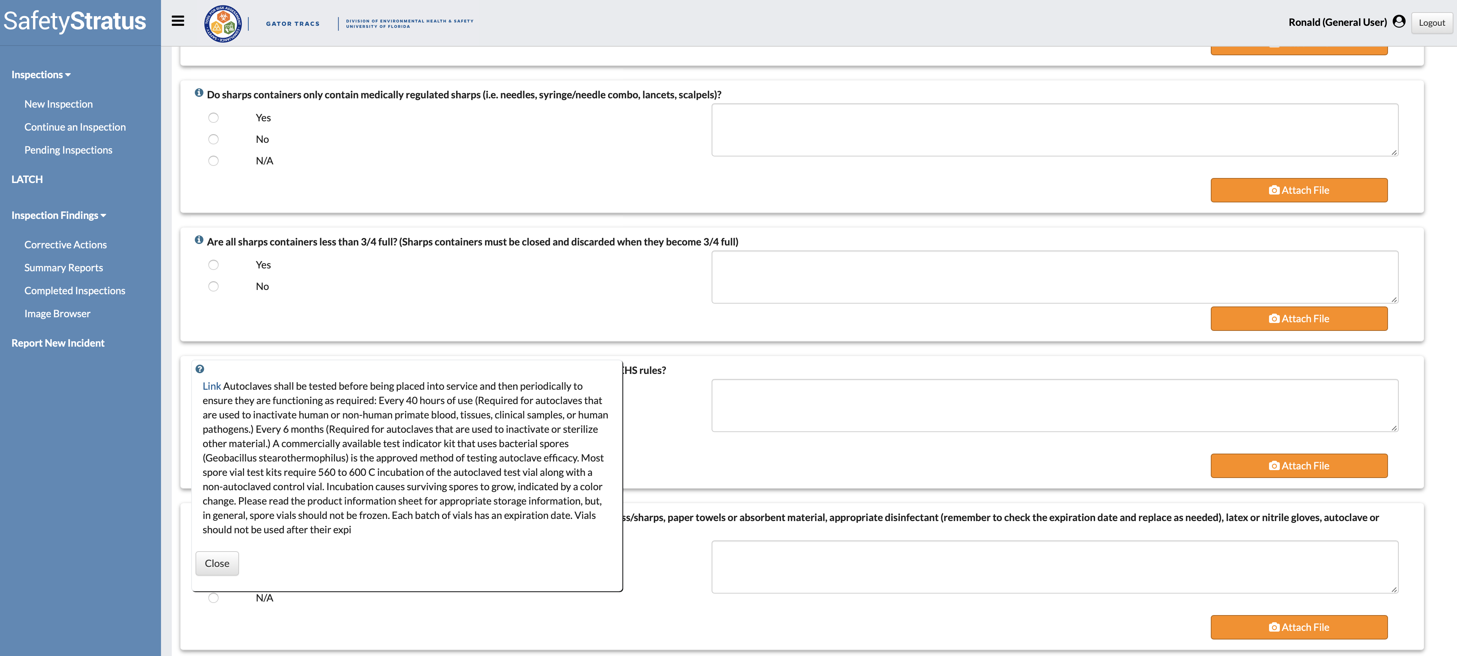
Click the “Link” to find more information on the topic.
Inspector help expanded view.

Slide 15
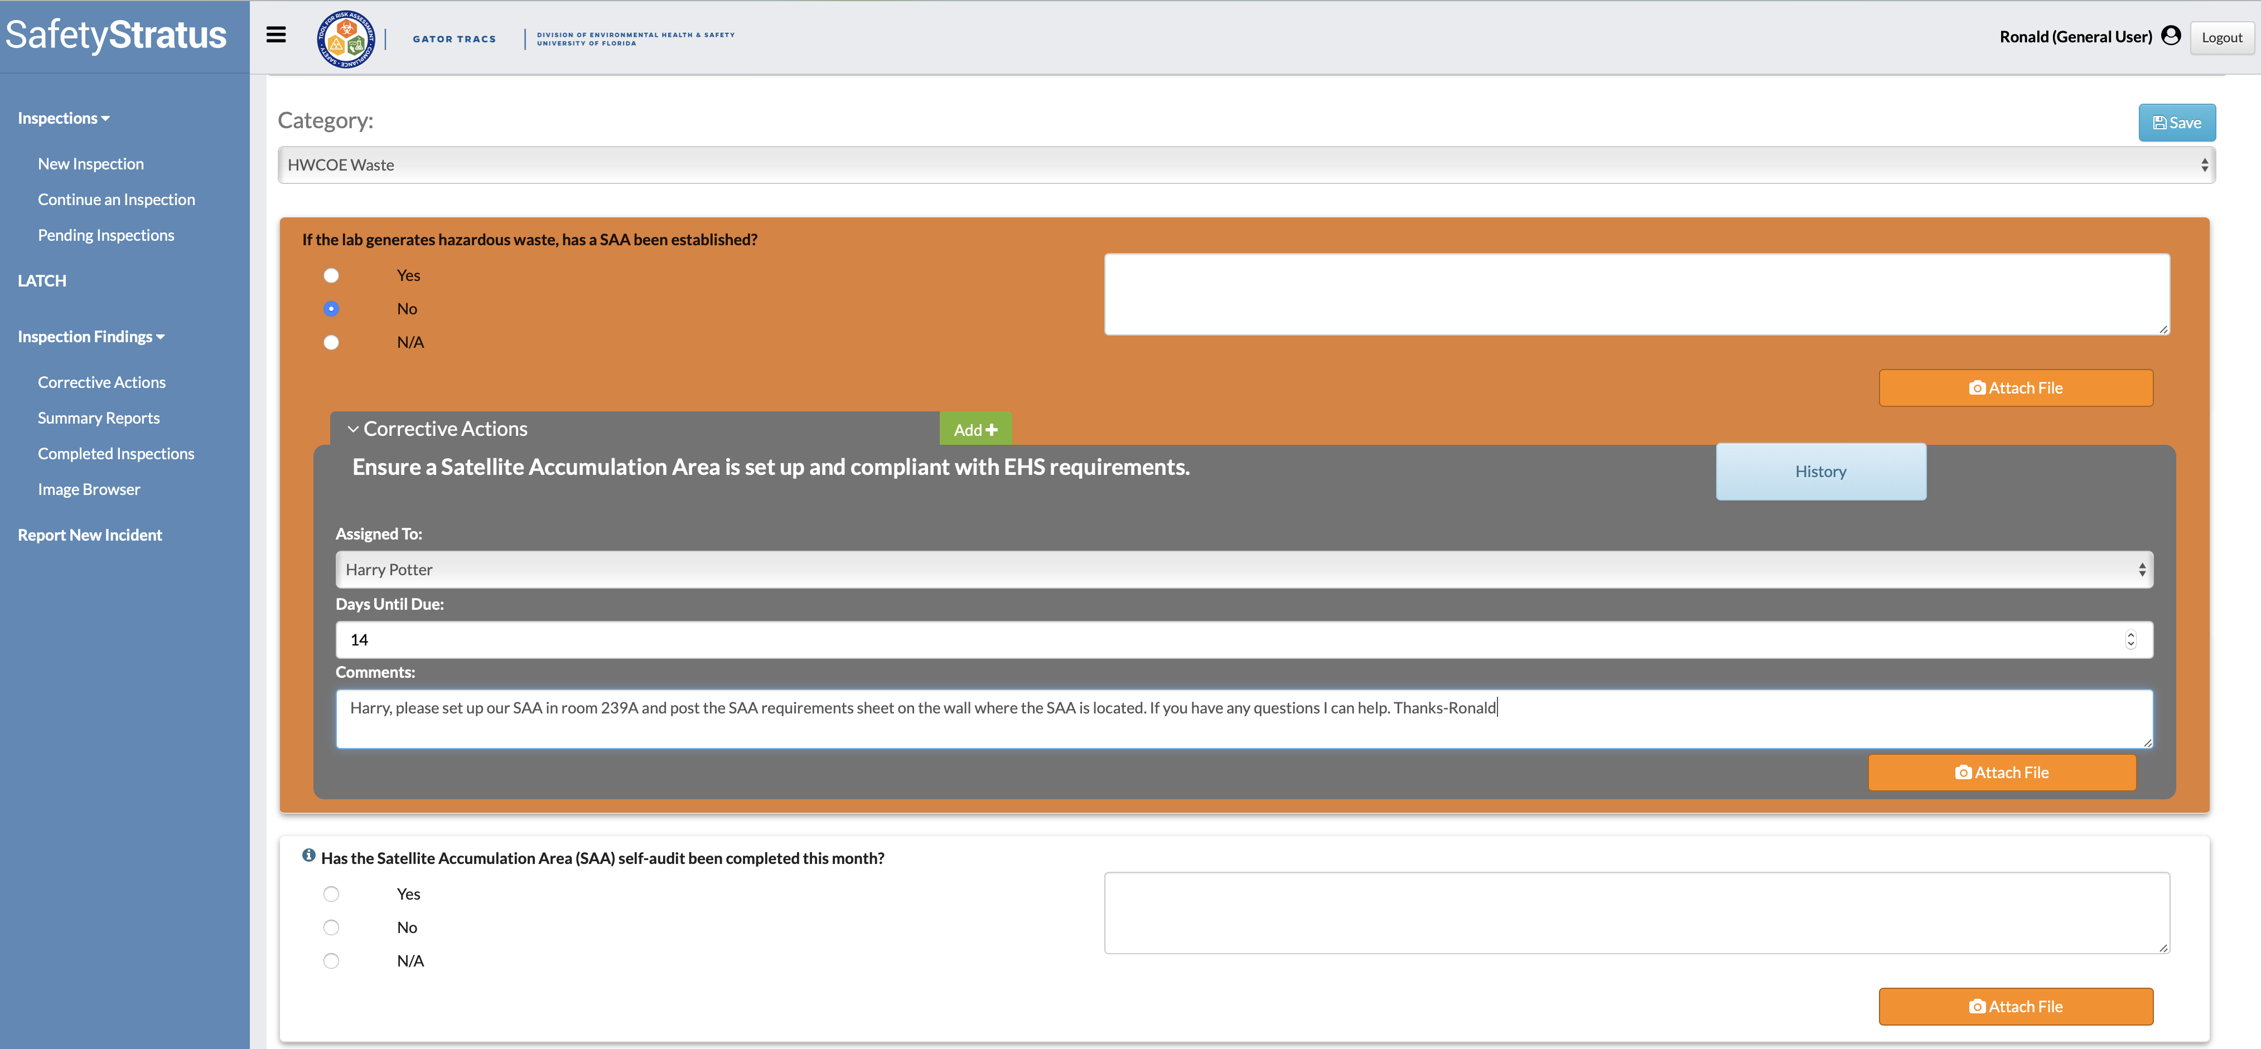
Corrective Actions (CA) are generated when the lab identifies a deficiency.
CAs can be assigned to anyone on the lab’s roster using the drop-down box Assigned To. Lab members with CAs assigned will be notified via email.

Slide 16
Comments can be added to further clarify the deficiency or action to be taken to correct it. Always include the room number if your inspection covers multiple rooms.
Add pictures by selecting “Attach File.” In many instances, pictures can be more helpful than comments.

Slide 17
When inspecting multiple rooms utilize the “Add” tool for assigning corrective actions to additional users. For example, there isn’t a SAA in 239A or 239B. The first CA is assigned to Harry and the room number is included in the comments. To add an additional CA to this question select “Add.”

Slide 18
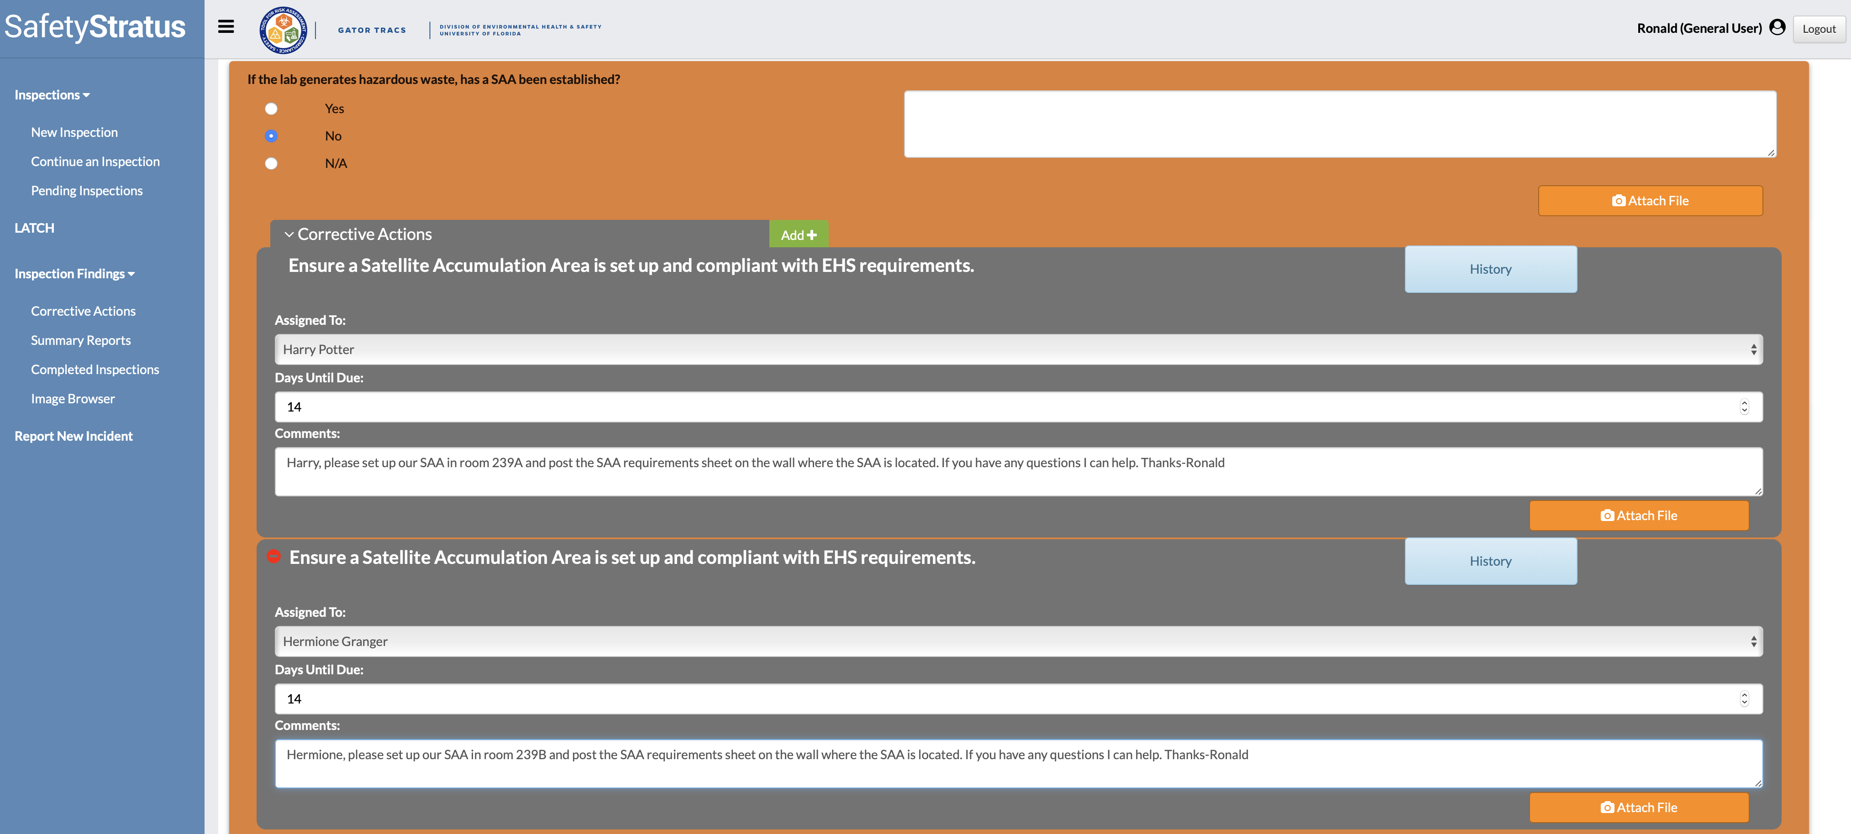
The new CA will display below the previous CA and will need to be assigned to the appropriate person.
Include the room as well as any applicable comments.

Slide 19
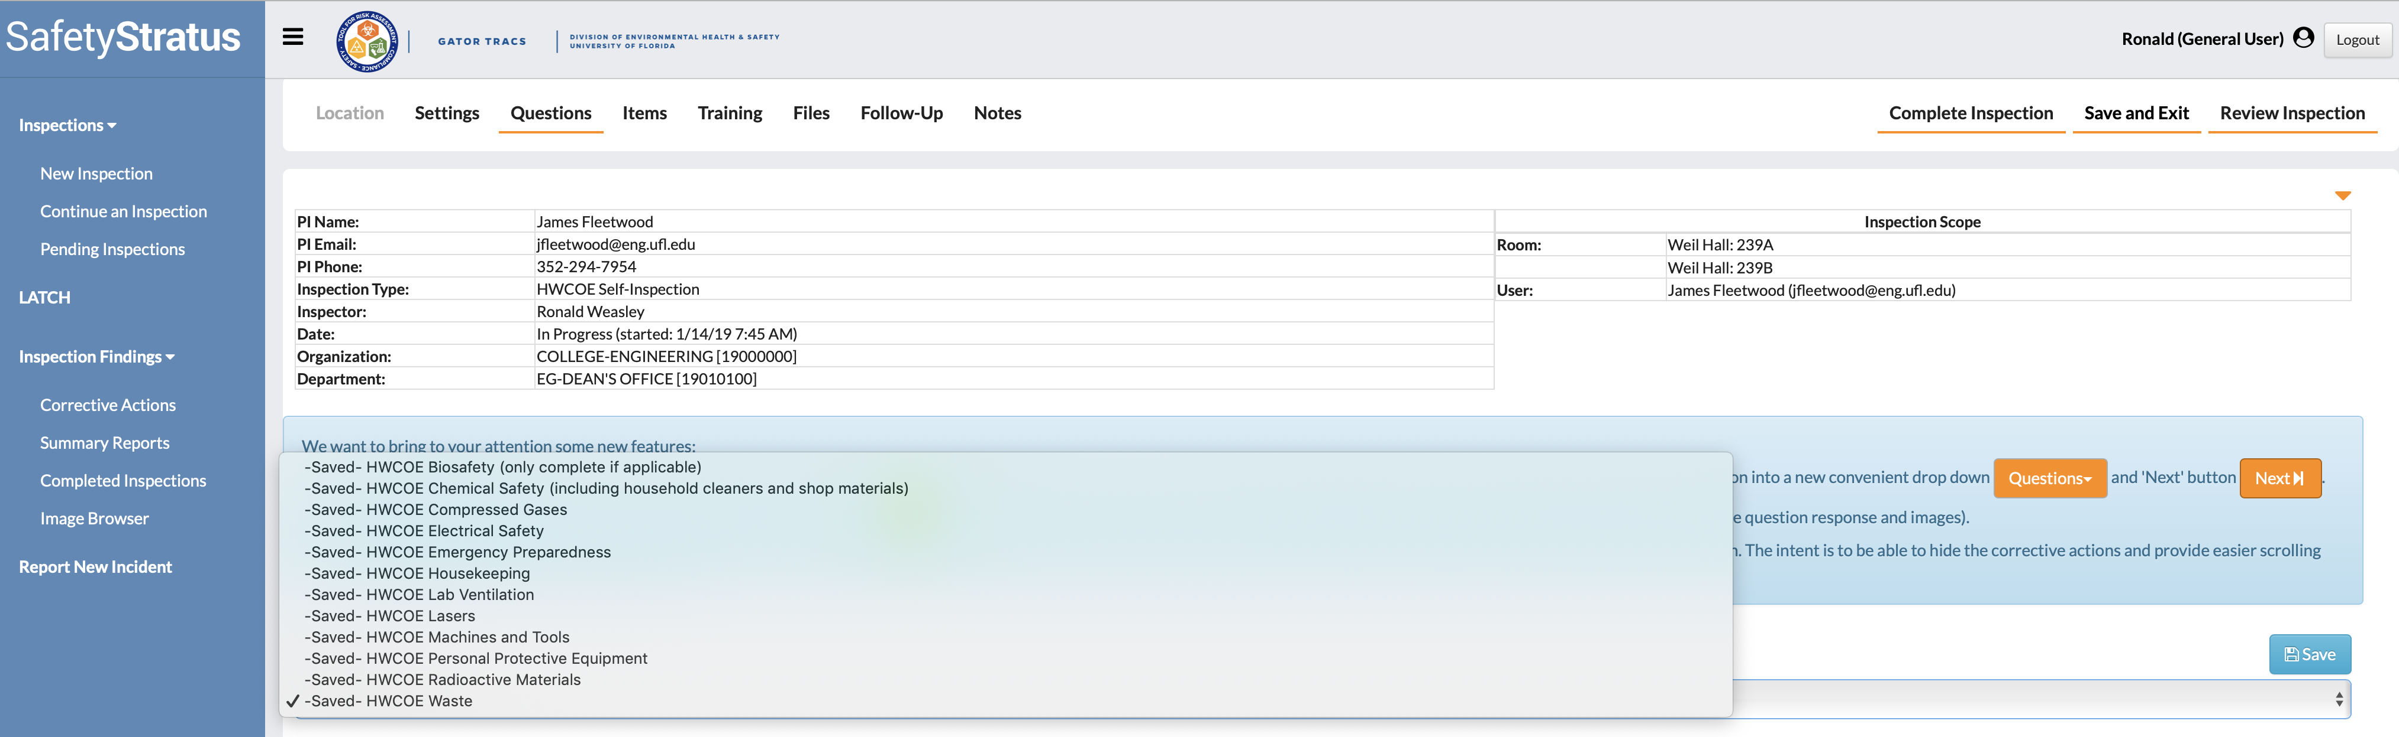
After answering all applicable questions click “Complete Inspection” when finished or “Save and Exit” to continue the self-inspection at a later date.

Slide 20
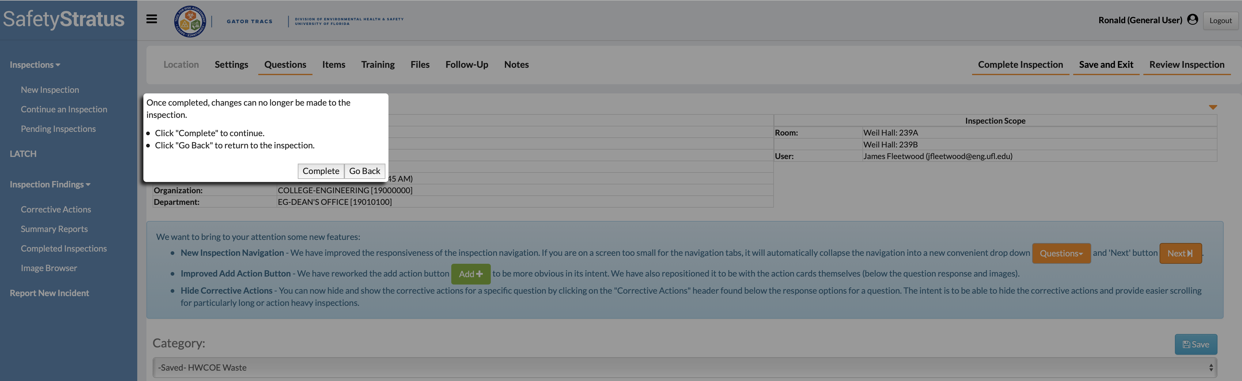
Select “Complete” to finalize the inspection.

Slide 21
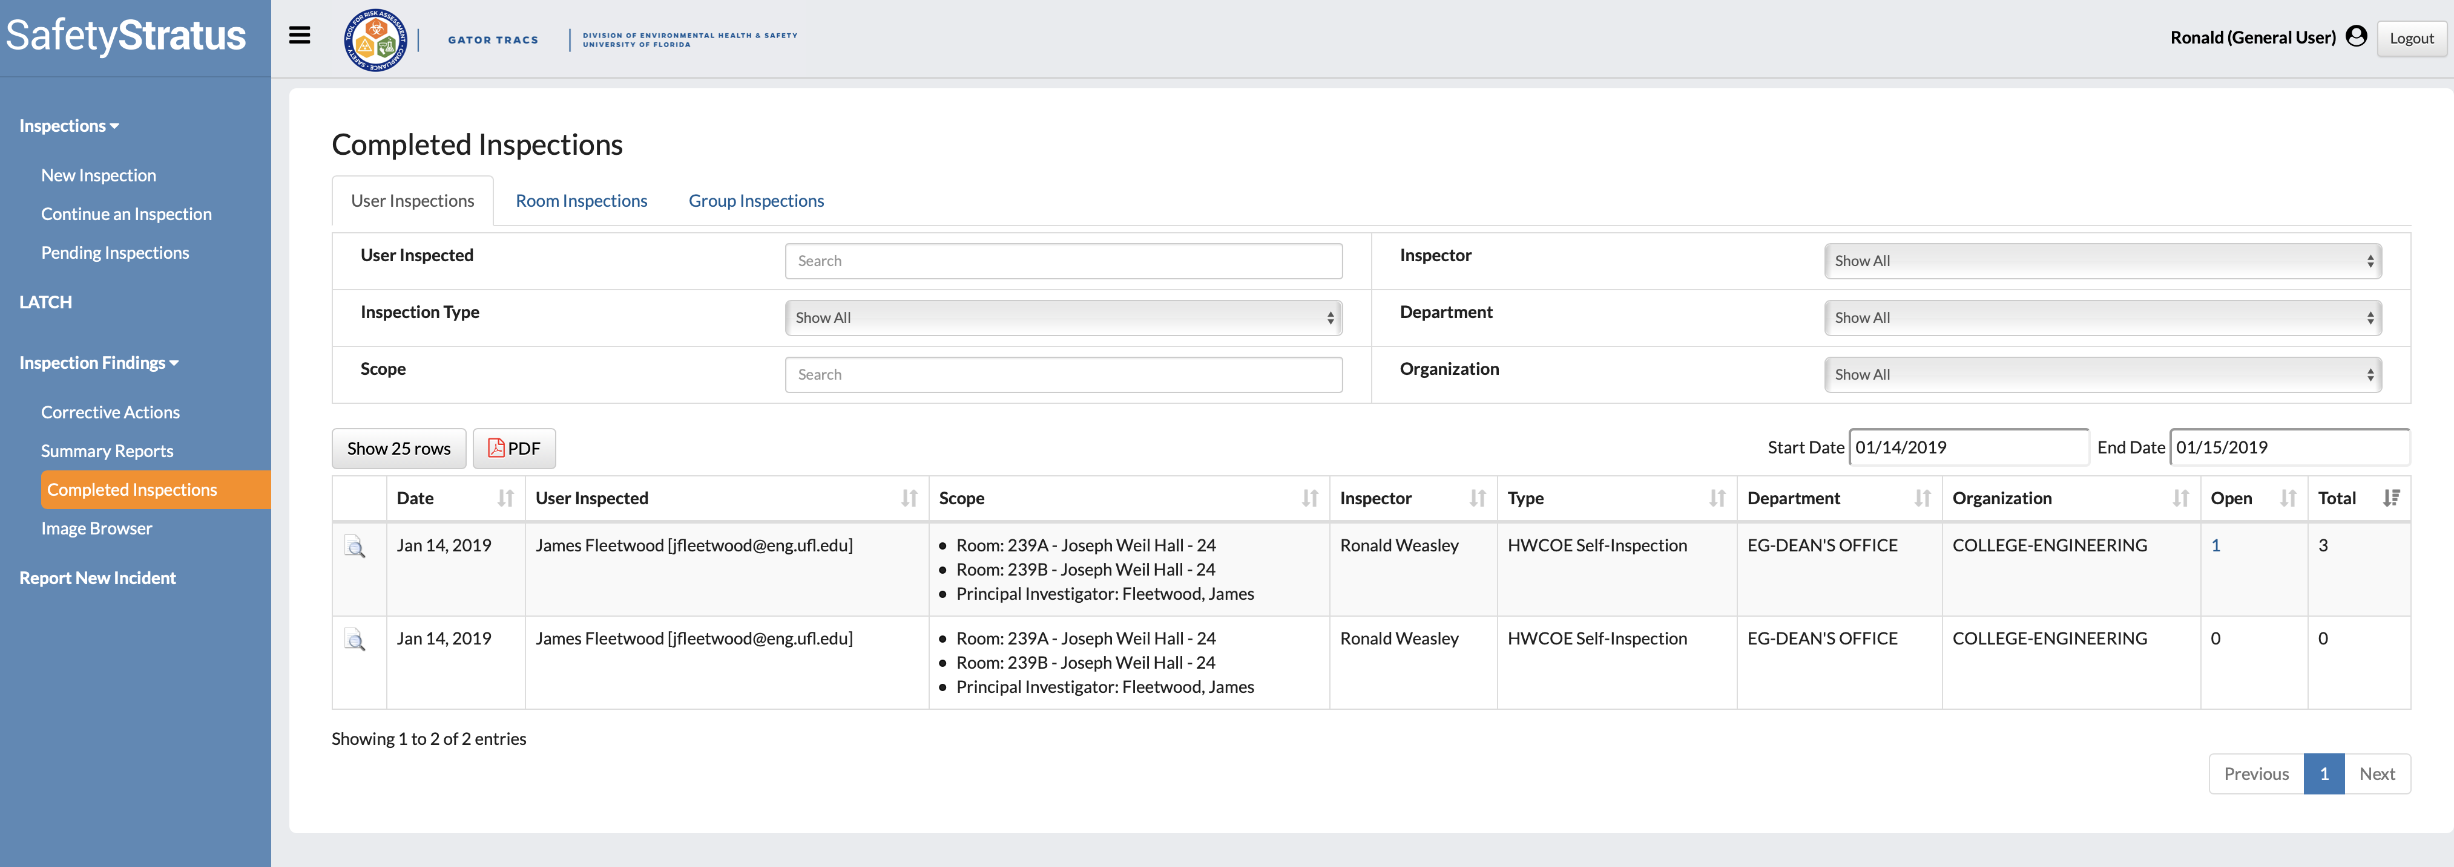
Verify the CAs are being completed in GatorTracs by selecting “Completed Inspections.”
When all CAs have been completed the “Open” column will display a zero. In this example, one CA is still open out of three that were assigned.
A help guide on how to complete CAs can be found here: http://webfiles.ehs.ufl.edu/GT/UF_HELP_PI_Corrective_Inspection.pdf

